Slide 1
PIPE REHABILIATION METHODS Ipsum

Slide 2
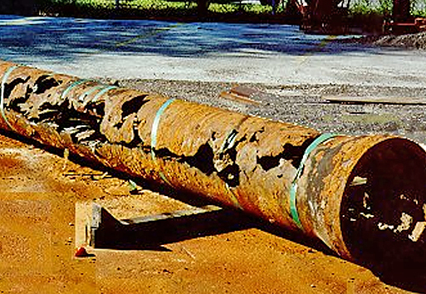
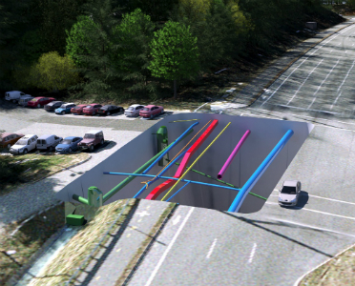
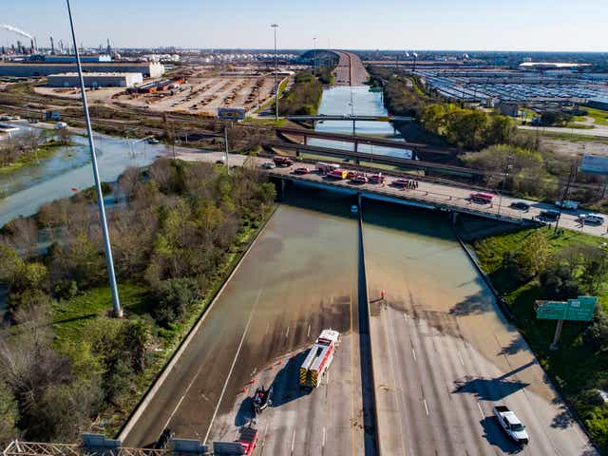
When is Pipe Rehabilitation Needed?
Existing Pipe is experience repeated failures and is at the end of useful life
Removal and Replacement of Pipe Cost Prohibitive or Not Feasible due to Significant Disruption
Emergency Repairs to Existing Pipe Needed

Slide 3
Categories of Pipe Rehabilitation
Replacement
Open-Cut Removal & Replacement
Sliplining & Swedglining
Spot Repair
Repair Sleeves
Joint Sealing
Corrosion Inhibition
Spray-on Lining
Structural Rehab
Cured-In Place Pipe (CIPP)
Pipe Bursting
Carbon Fiber Wrap
External Reinforcement
Inserted Hose Lining

Slide 4
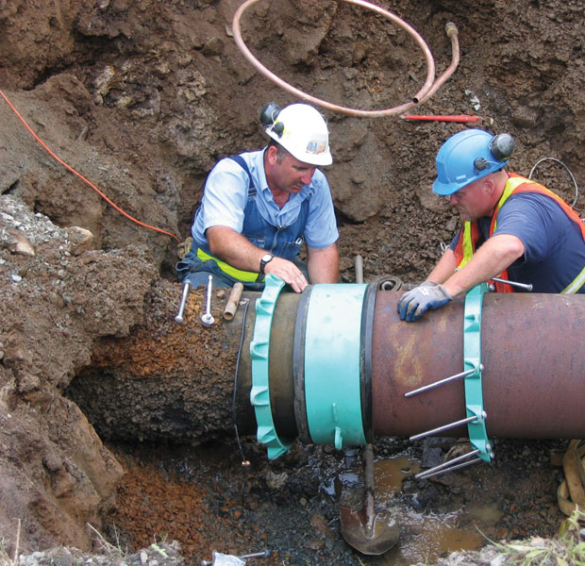
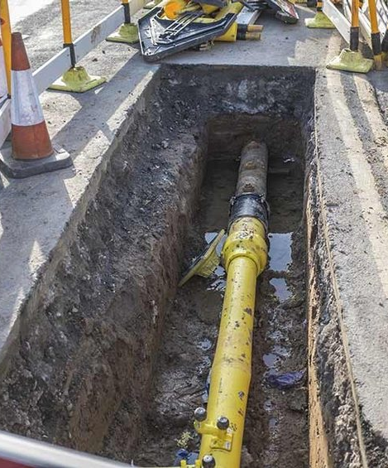
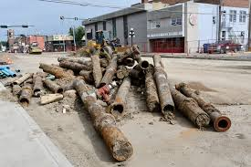
Replacement –Open-Cut Removal & Replacement
Removal of old pipe and replacement with brand new pipe. Most of the time this method requires open-cut excavation to access old pipe.
Addresses most problems with old pipe
Disadvantages:
Costly Option
Can be very disruptive
Can take a long time to plan, design and construction project

Slide 5
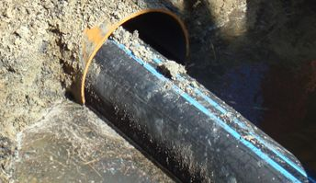
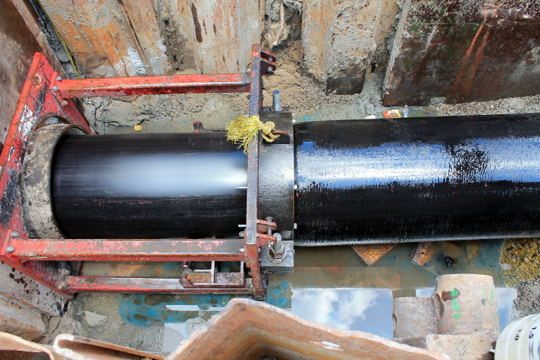
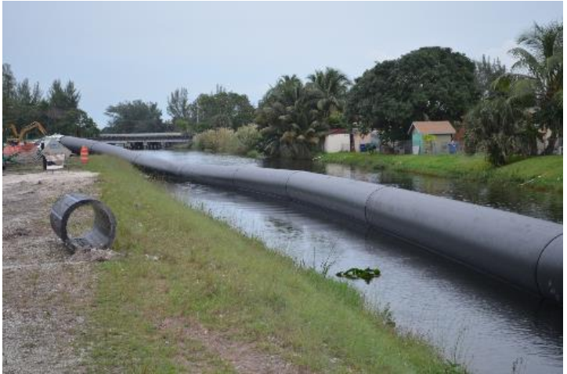
Replacement – Sliplining and Swedgelining
Sliplining: Uses smaller loose-fitting flexible plastic/fiberglass pipe that is inserted directly inside older pipe.
Swedgelining: Uses close-fitting flexible thermoplastic pipe that is inserted directly inside older pipe
Disadvantages:
Maximum lengths of up to 1,500LF -2,000 LF feasible
Still requires excavation and removal & replacement of appurtenances, fittings and bends
Specialized crew and equipment required
Lots of work room require when laying pipe

Slide 6
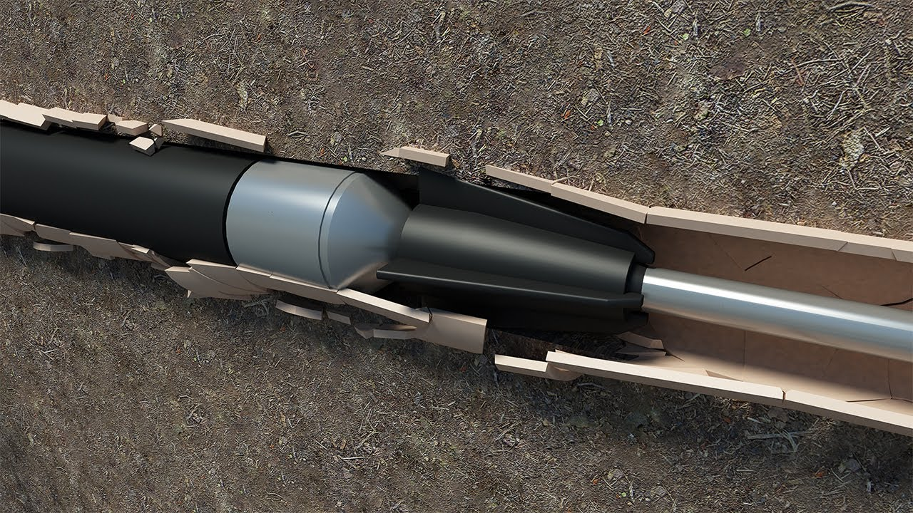
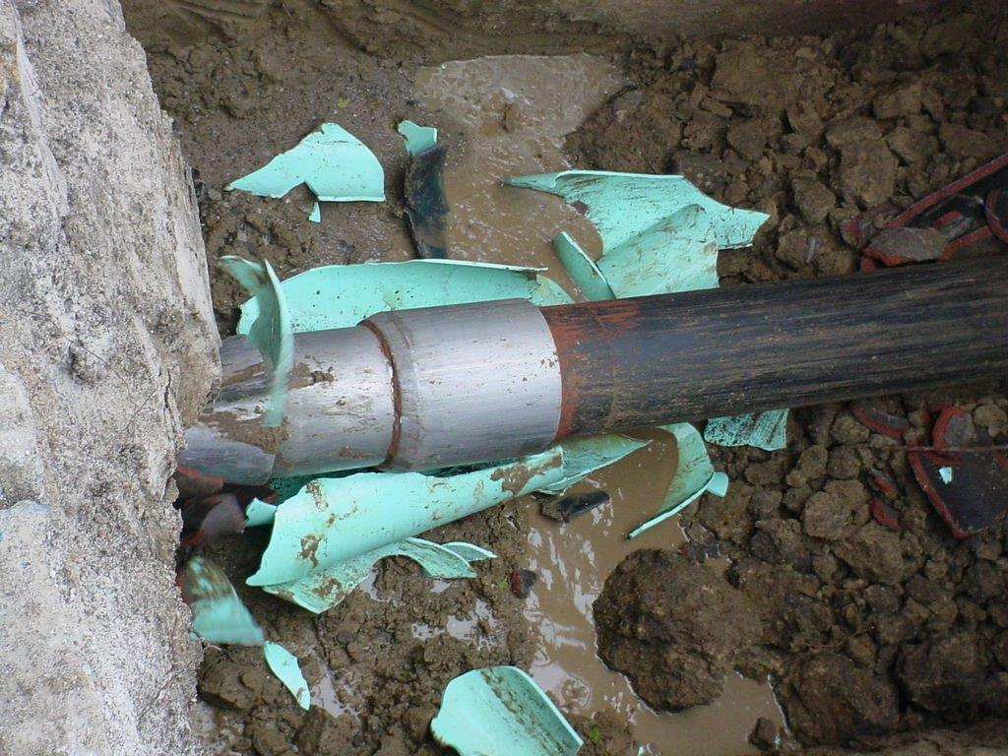
Replacement – Pipe Bursting
Method of ramming a bigger pipe inside an existing smaller pipe by breaking apart the pipe buried
Disadvantage:
Only suitable when existing pipe is brittle and can be easily broken apart
Not commonly used in Waterline

Slide 7
Categories of Pipe Rehabilitation
Replacement
Open-Cut Removal & Replacement
Sliplining & Swedglining
Spot Repair
Repair Sleeves
Joint Sealing
Corrosion Inhibition
Spray-on Lining
Structural Rehab
Cured-In Place Pipe (CIPP)
Pipe Bursting
Carbon Fiber Wrap
External Reinforcement
Inserted Hose Lining

Slide 8
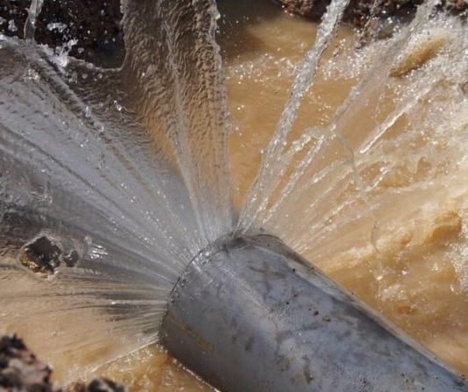
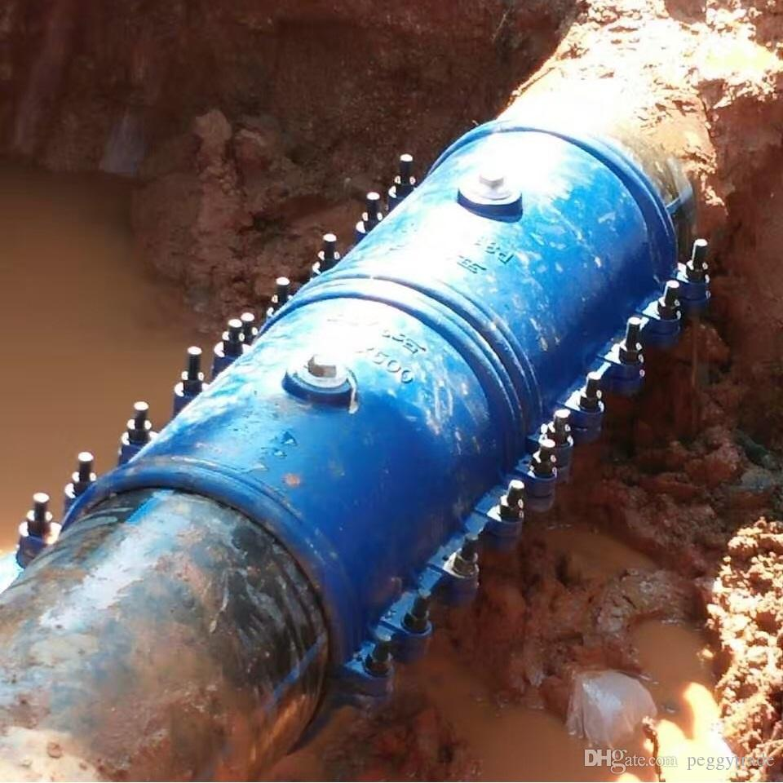
Spot Repair– Sleeves
Pre-fabricated sleeves that are able to plug leaks and other non-structural issues in the pipe
Can be installed with minimal equipment and within a short amount of time
Disadvantages:
More of a reactive measure. Does not address underlying problems with pipe
Not suitable for larger diameter pipes
Require excavation of pipe

Slide 9
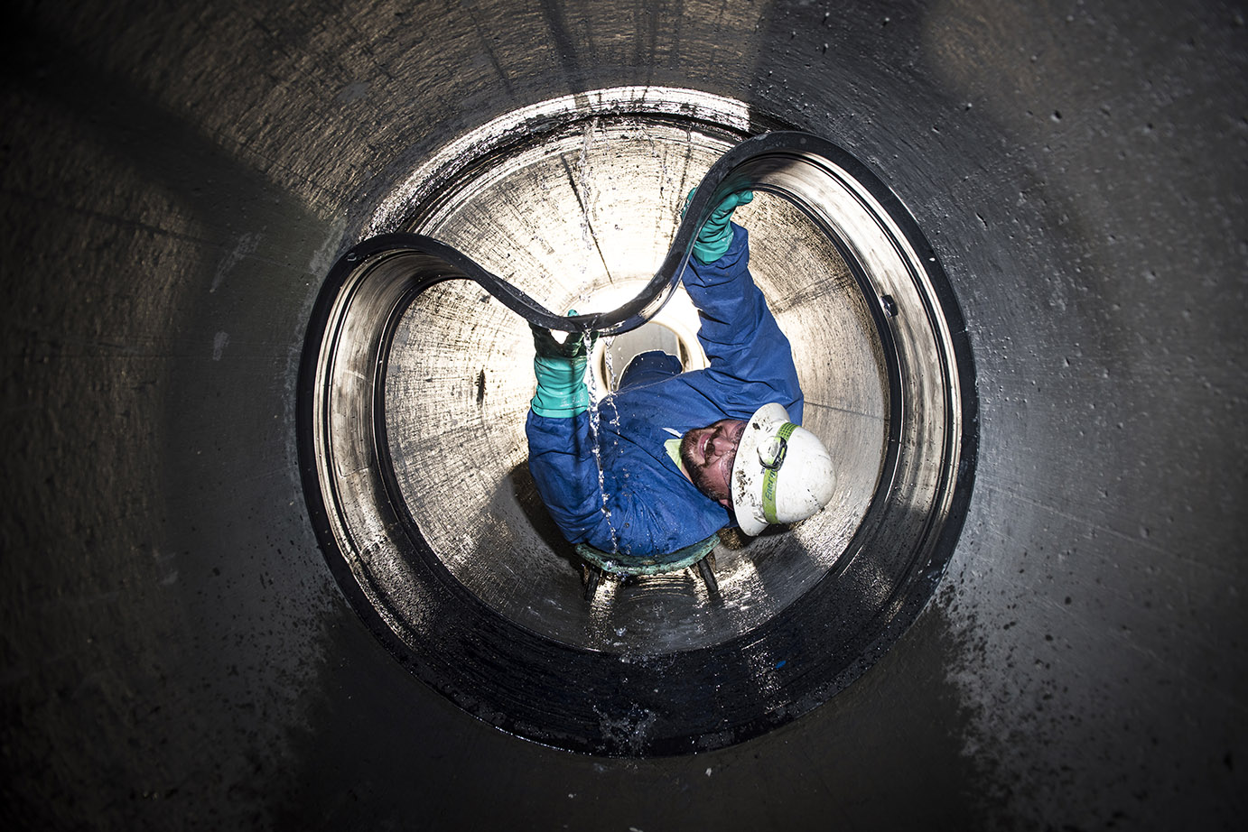
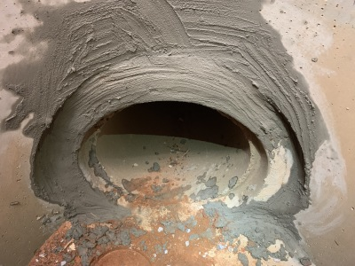
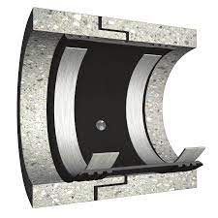
Spot Repair– Internal Joint Sealing
Internal prefabricated polymer compression seals that are used to seal leaking joints, cracks or small holes in pipe.
Grout can also be used to seal joints
Disadvantages:
Requires shutting-down and entering pipe
Cannot address structural deficiencies with pipe

Slide 10
Categories of Pipe Rehabilitation
Replacement
Open-Cut Removal & Replacement
Sliplining & Swedglining
Spot Repair
Repair Sleeves
Joint Sealing
Corrosion Inhibition
Spray-on Lining
Structural Rehab
Cured-In Place Pipe (CIPP)
Pipe Bursting
Carbon Fiber Wrap
External Reinforcement
Inserted Hose Lining

Slide 11
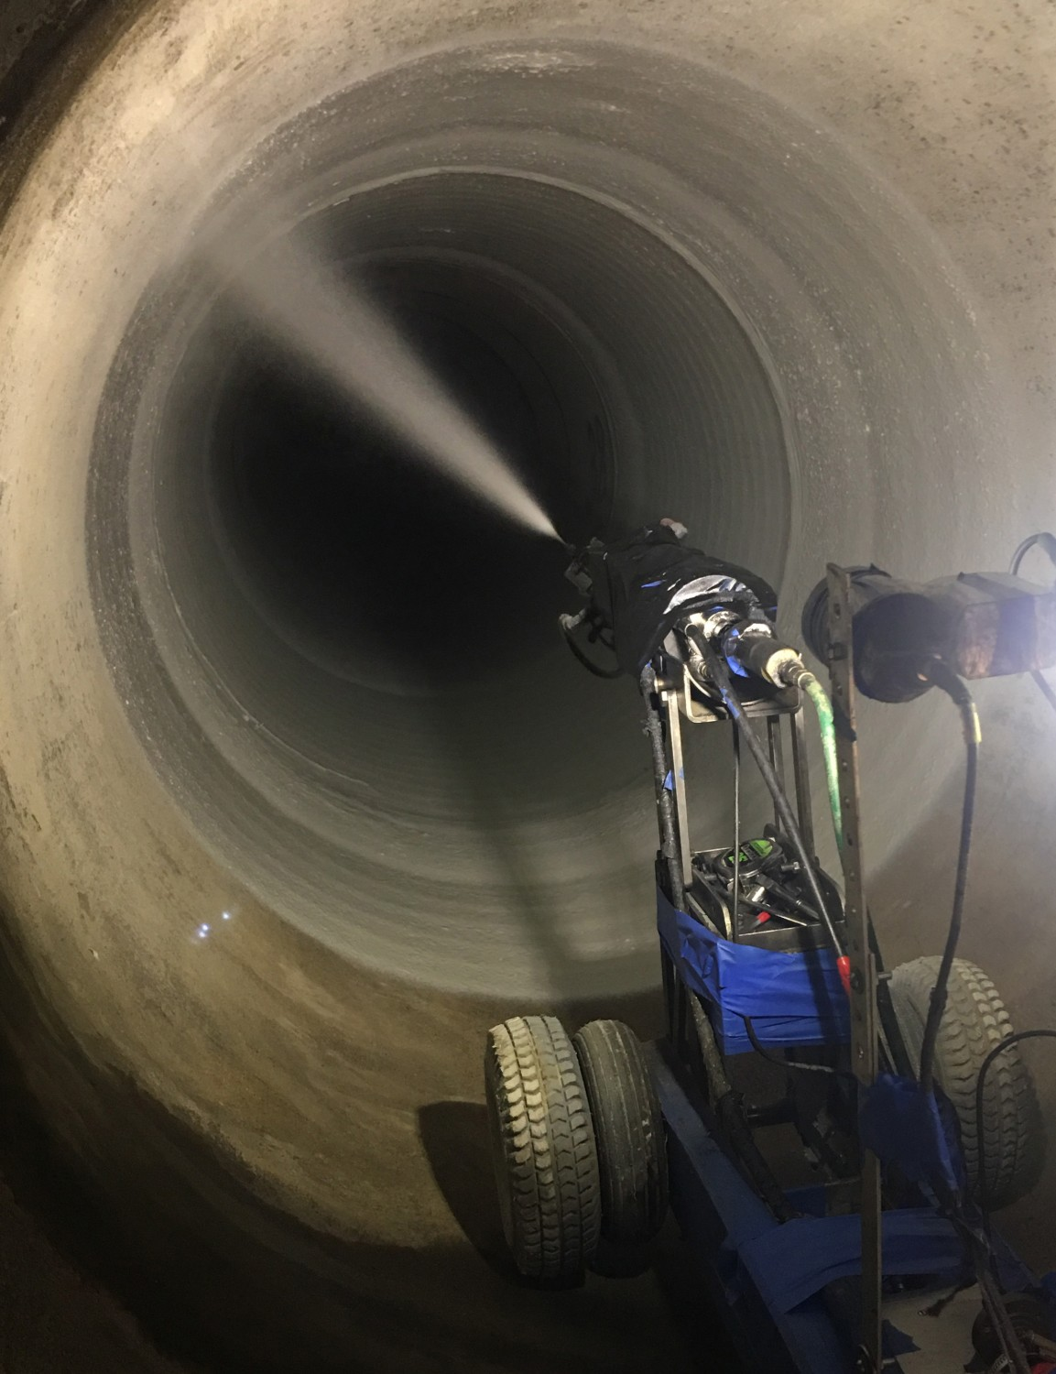
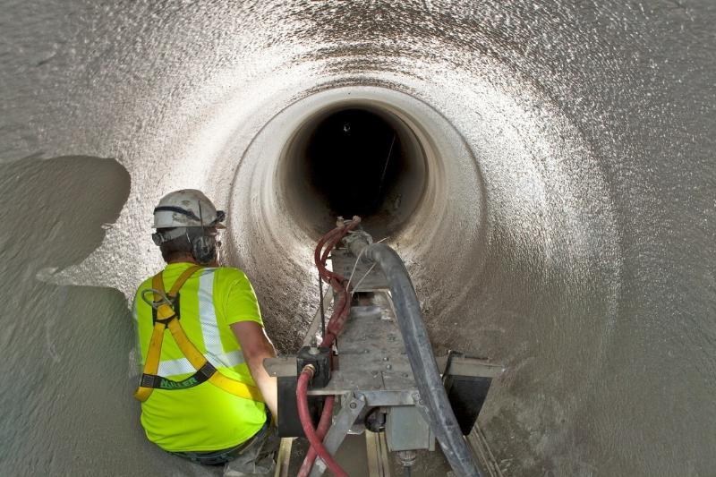
Corrosion Inhibition– Spay-On Lining
Sprayed polyurethane lining that is applied directly to the inside of the pipe to provide corrosion protection
Grout can also be used to seal joints
Disadvantages:
Requires shutting-down and entering pipe
Cannot address structural deficiencies with pipe
Requires some time to cure

Slide 12
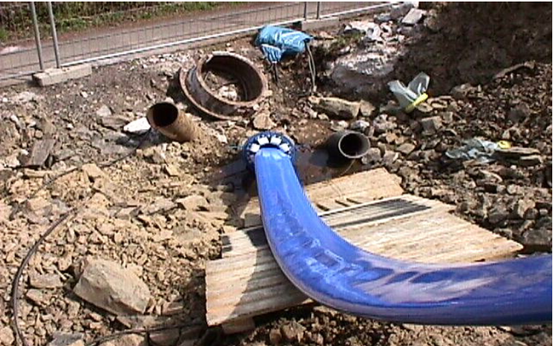
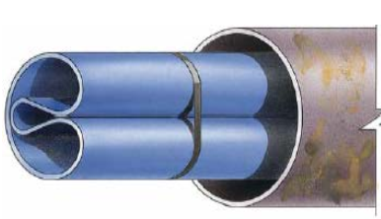
Corrosion Inhibition– Inserted Hose Lining
Woven polyster or Kevlar hoses that are winched inside the pipe folded and reverted to the shape of the pipe with air, steam or water.
Provides corrosion protection to inside of pipe that can be installed within a short amount of time
Disadvantages:
Requires shutting-down
Cannot address structural deficiencies with pipe
Block access manholes, services connections. Additional cutting required

Slide 13
Categories of Pipe Rehabilitation
Replacement
Open-Cut Removal & Replacement
Sliplining & Swedglining
Spot Repair
Repair Sleeves
Joint Sealing
Corrosion Inhibition
Spray-on Lining
Structural Rehab
Cured-In Place Pipe (CIPP)
Pipe Bursting
Carbon Fiber Wrap
External Reinforcement
Inserted Hose Lining

Slide 14
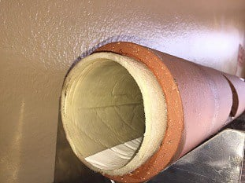
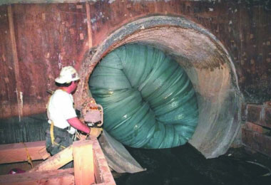
Structural Rehab– Cured-In Place Pipe (CIPP)
Method involves inserting a polymer reinforced sleeve coated with thermoset resin into existing pipe. An air bladder makes the sleeve expand
When cured, CIPP becomes rigid and provides full structural support and corrosion protection
Disadvantages:
Requires shutting-down
Limited rehab lengths and requires an entry and exit points

Slide 15
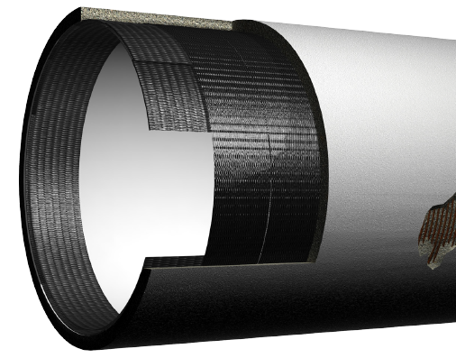
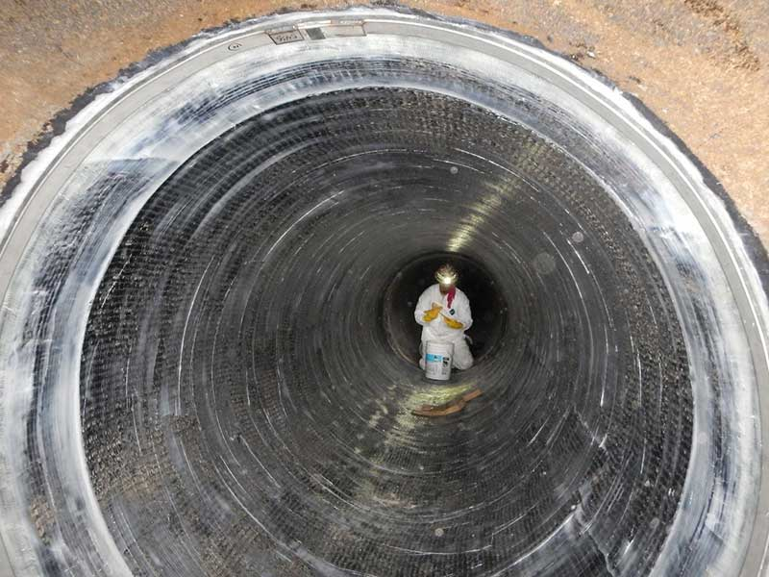
Structural Rehab– Carbon Fiber Wrap
Internal method of applying carbon-fiber & epoxy resin composite to inside of pipe
When cured, carbon-fiber wrap provides corrosion protection and increase pipe strength
Disadvantages:
Requires shutting-down and entire pipe
Limited to straight section of pipe, no bends or fittings
Expensive and requires highly skilled workers

Slide 16
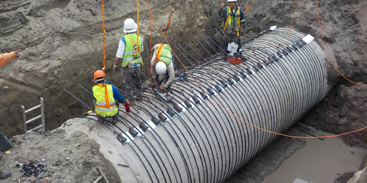
Structural Rehab– External Reinforcement
Method of installing addition structural sleeves, rebar and concrete on outside of pipe to provide structural reinforcement
Disadvantages:
Requires Excavation of Pipe if pipe is buried
Is only able to address structure concerns of a small segment of pipe

Slide 17
Q&A

