Slide 1
Pipe Joints – Steel Pipe

Slide 2
Main Type of Unrestrained Joints
Bell and Spigot Rubber Gasketed Joint
Unrestrained Bolted Steel Coupling
Unrestrained Bolted Split-Sleeve Coupling
Permalok (Steel Casing)

Slide 3
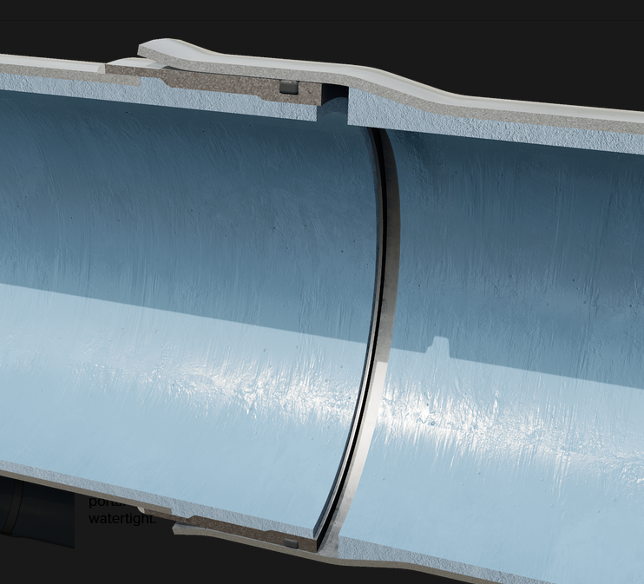
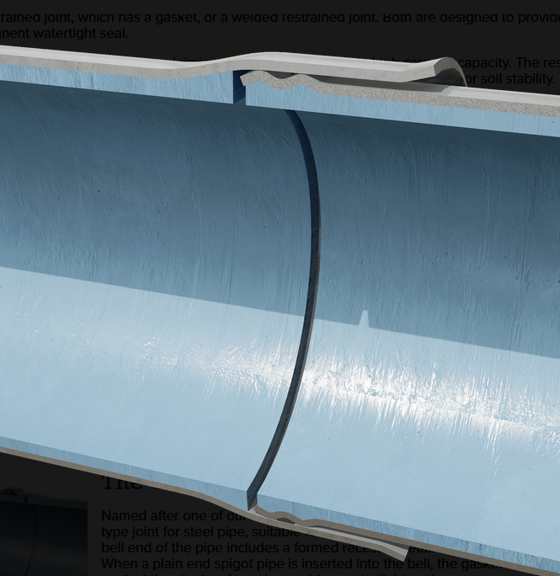
Bell & Spigot Joint
Easy to Assemble, Self Centering, Economical
Allows Joint to be offset to create long-radius curves
Typically only suitable to Pipes <= 72 inches
Unrestrained. Should not be used in areas subject to thurst (elbows, tees, valves, dead-ends)
https://youtu.be/rSQLSOkJnY0?t=40

Slide 4
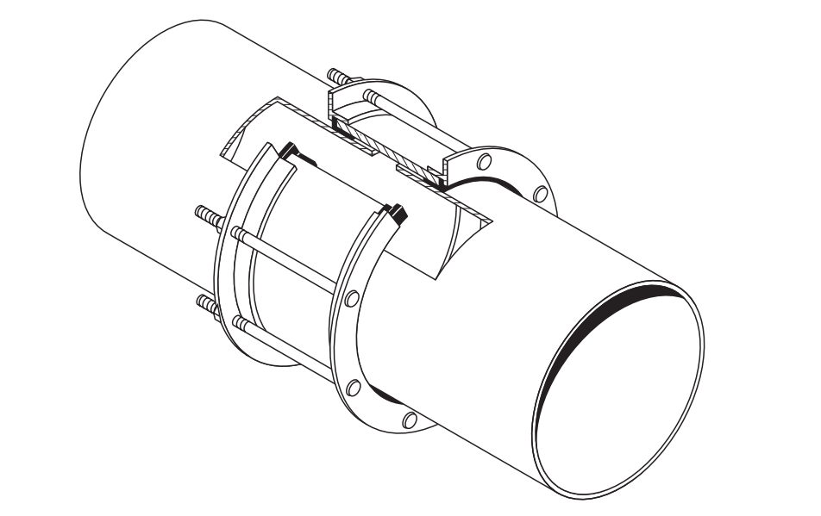
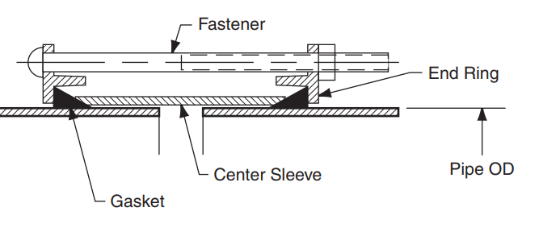
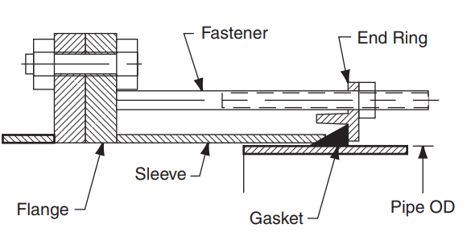
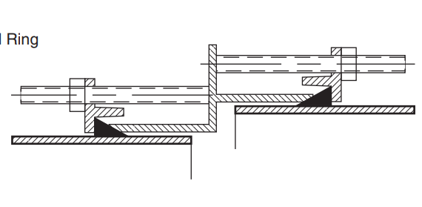
Bolted Sleeve Coupling (1)
This type of couplings are used for:
Relive stresses on pipe due to small amounts thermal expansion or differential settlement
Joining plain-end pipe to flange adapters
Jointing pipe of different diameter or materials
Axial movement of pipes allowed through the shearing of the rubber gasket
Not intended for application where pipe will experience shear or bending moments

Slide 5
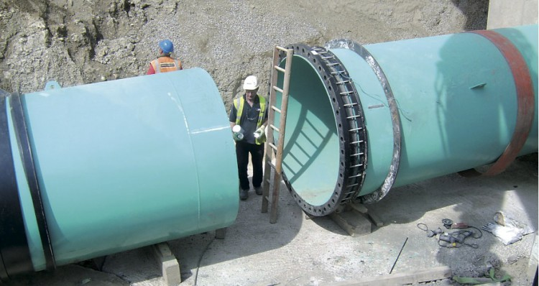
Bolted Sleeve Coupling (2)

Slide 6
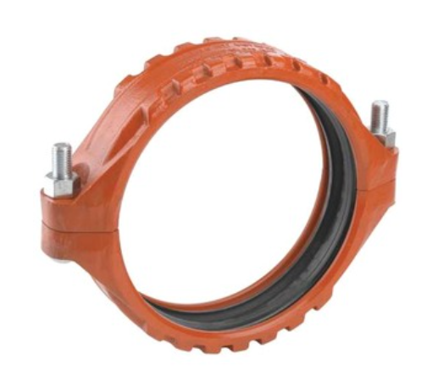
Bolted Split-Sleeve Coupling (1)
Clamp-like joint couplings used to:
Allow some lateral movement of the pipe due to settlement
Allows some axial movement (1/2”) to relieve stresses on pipe due to thermal contraction or expansion
Easier to install and more flexible than bolted steel coupling
Not intended for application where pipe will experience shear or bending moments

Slide 7
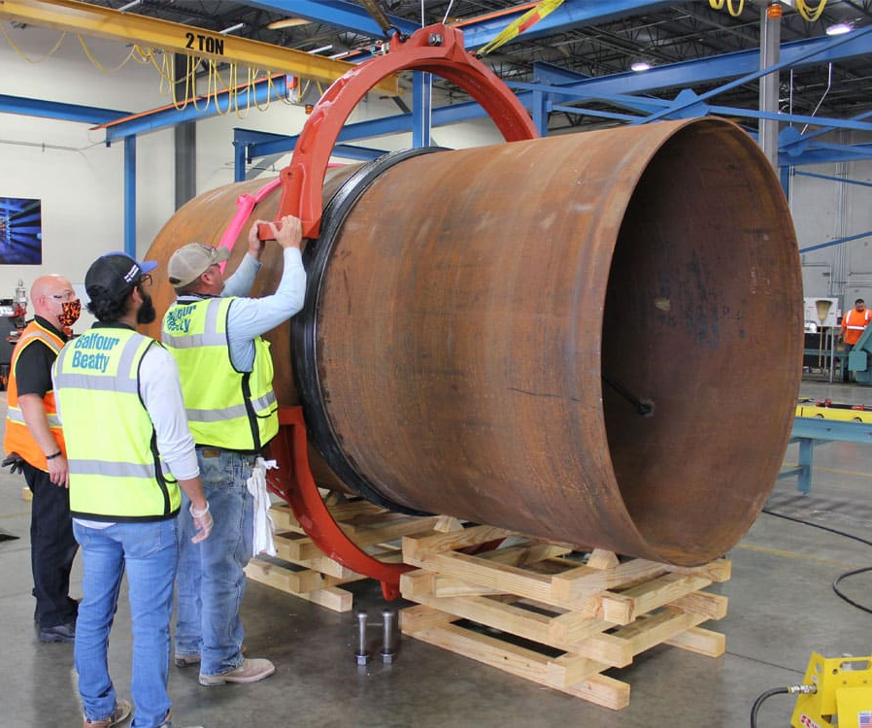
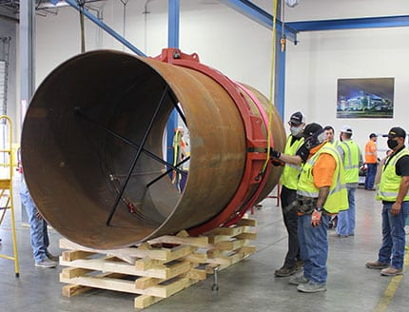
Bolted Split-Sleeve Coupling (2)

Slide 8
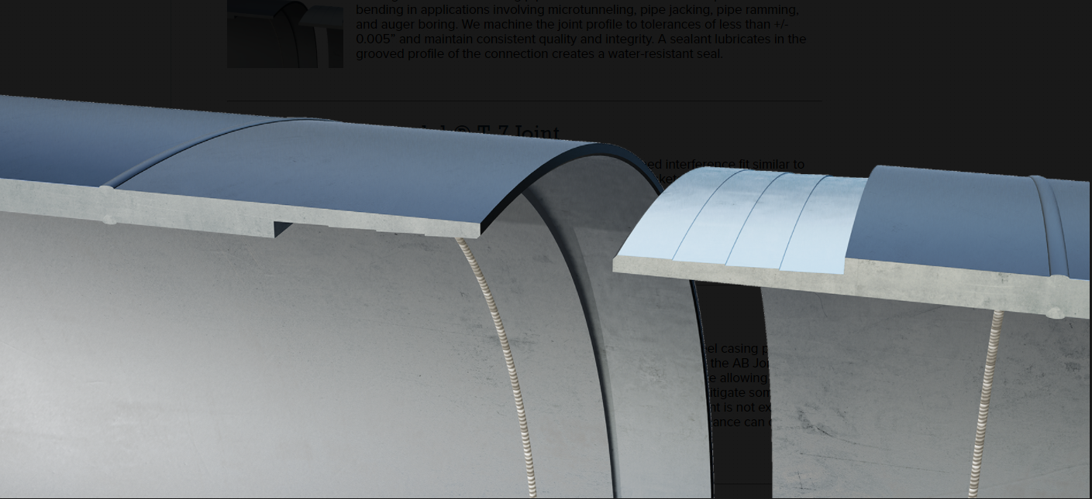
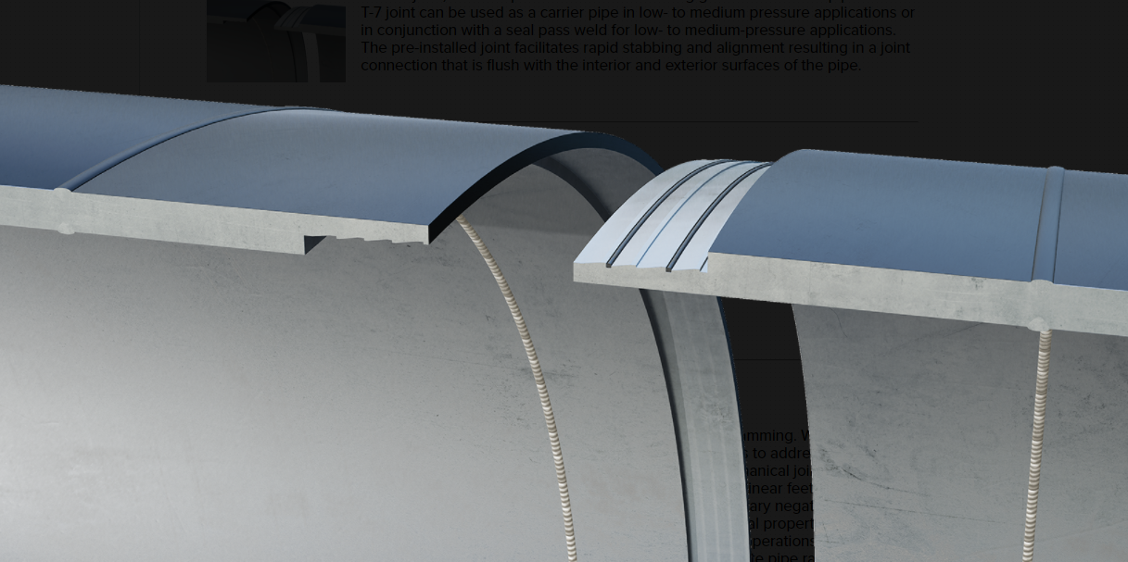
Steel Casing - Permalok
Interlocking Joint is not design to handle internal pressure, therefore most often used in Casings
Installation is similar to bell and spigot in that be it only requires the both ends of the pipe to be joined together
Joint eliminates the need to field weld casing
Different types of joints exists for different application (HDD, pipe jacking, ect)

Slide 9
Main Type Restrained Joints
Field Welded Joint
Flanged Joint
Mechanical Joint
Bolted Sleeve Coupling
Bolted Split-Sleeve Coupling
Grooved and Shouldered Coupling
Mechanical Slip Expansion Joint

Slide 10
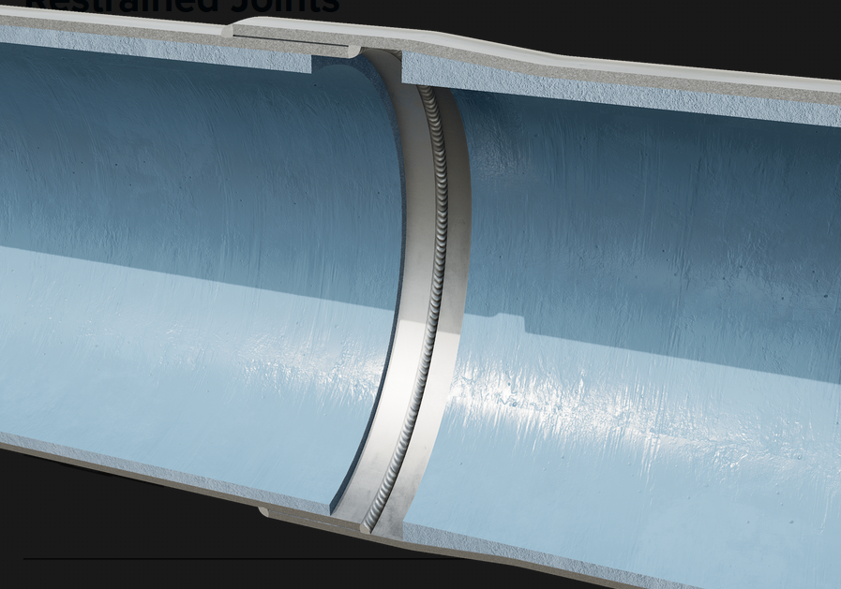
Field Welded Joint (1)
Lap-Welded Joint
Restrained Joints created by expanding one side of a pipe (bell) and inserting a plain end (spigot)
Pipe are secured with either an internal or external, or both depending on diameter, circumference fillet weld equal to thickness of pipe
Most common restrain joint type for Steel
Allows Joint to be offset up to 2-3 degrees by pulling joint
With join installed, a heat-shrink sleeve is install around the exposed pipe
https://www.youtube.com/watch?v=iVs5FvvqPl0

Slide 11
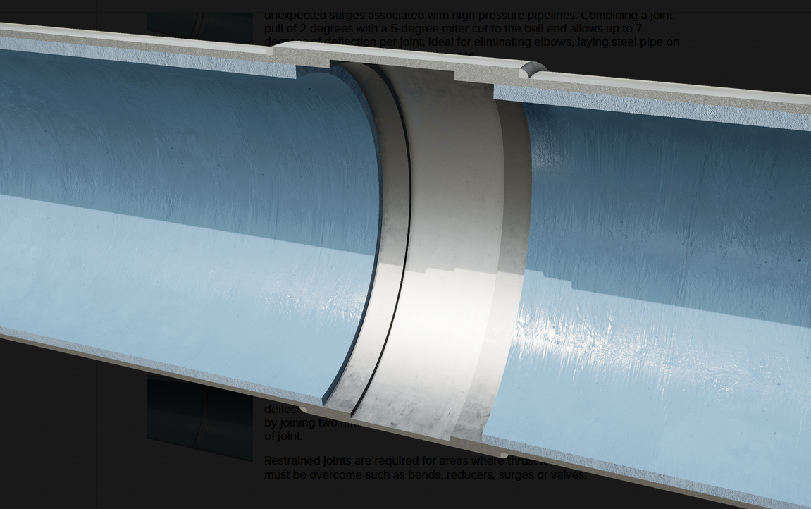
Field Welded Joint (2)
Butt-Strap Joint
Restrained Joint
Often used for field adjustments
Allows for a gap to exist between two pipe pieces

Slide 12
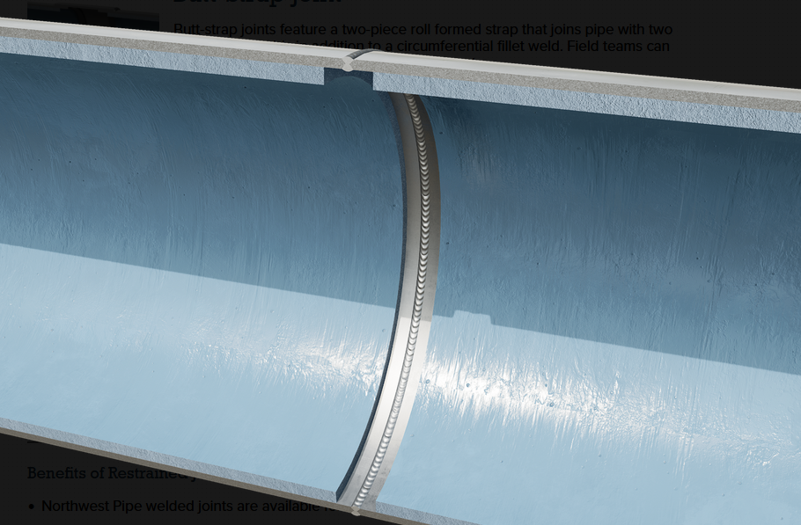
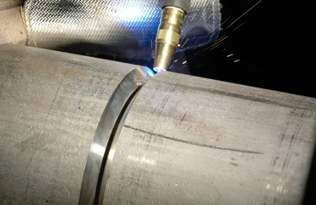
Field Welded Joint (3)
Butt-Welded Joints
Both pipes needs to be plain ends or bevel ends.
Typically, both pipes needs to have similar wall thickness
Full penetration weld required
https://youtu.be/dkASZEm1RZ4?t=10

Slide 13
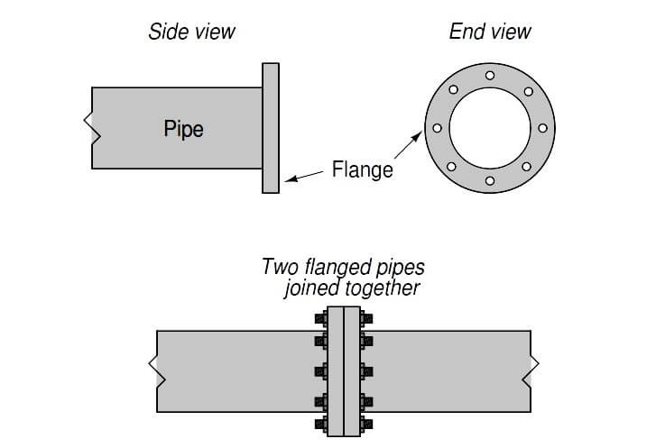
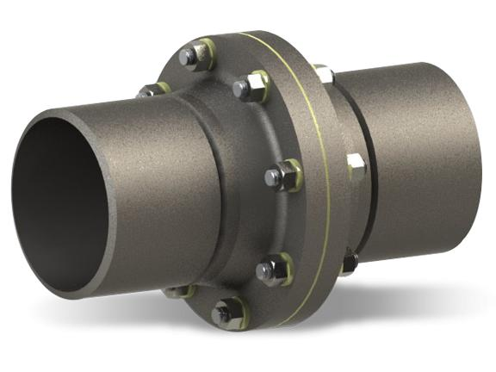
Flanged Joints
Used at location that will require future disassembly of joint for maintenance
For flanges to properly seal, both ends need to be parallel, and property aligned
3 main components of a flange:
Flange – fabricated ends of pipe with pre-made holes
Fasteners – bolts, nuts and washers that create the axial load to seal the joint
Gasket – deformable joint that seals joint and makes it watertight.
All components must be design to withstand the environment where they are on.

Slide 14
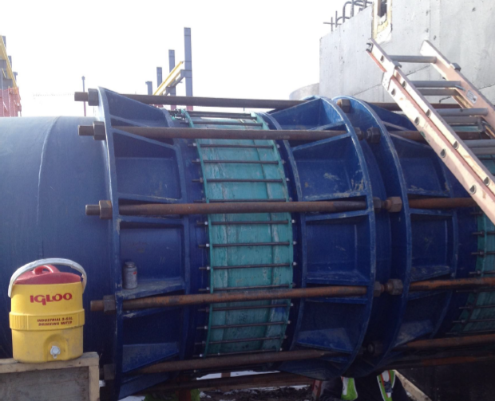
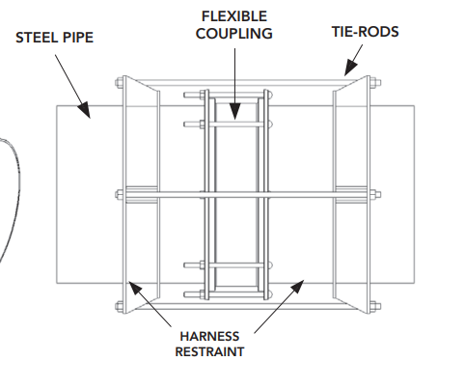
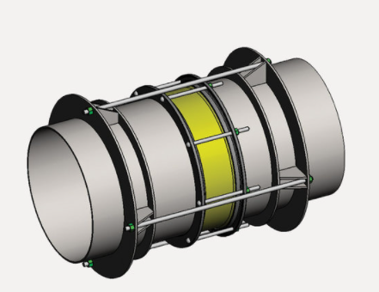
Restrained Bolted Sleeve Coupling
In order to restrained a bolted sleeve coupling, an external harness is needed with rods that prevent pipe from slipping out.
Allows some axial movement without pulling the pipe joint

Slide 15
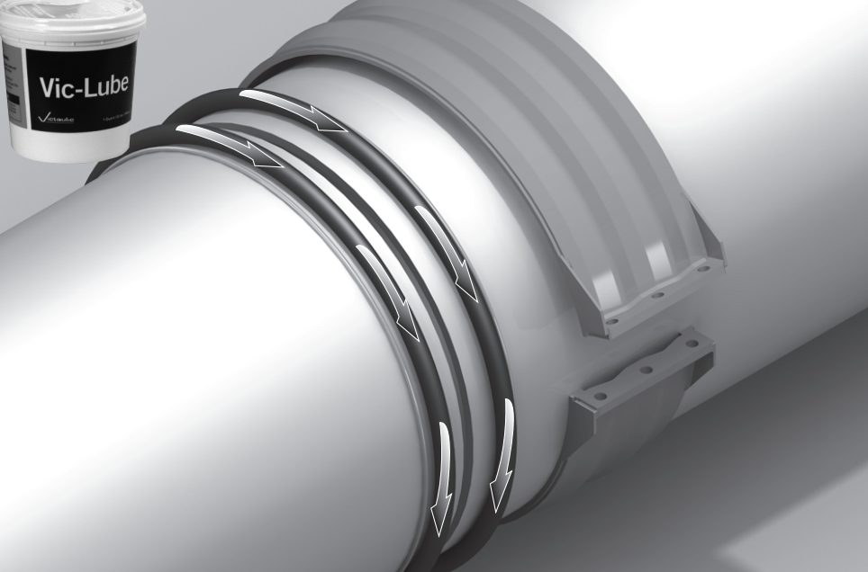
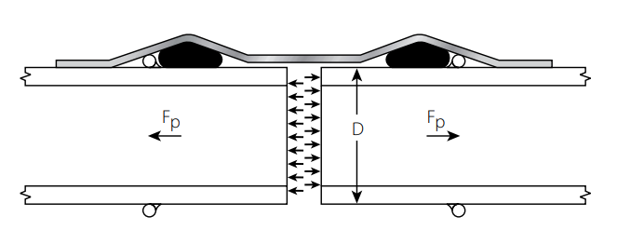
Restrained Bolted Split-Sleeve Coupling
Restrained Bolted Split-Sleeve coupling utilize a ring that is welded to each pipe. The coupling straddles these restrained rings and resist axial thrust
No need for an external harness
Allows some axial movement without pulling the joint.

Slide 16
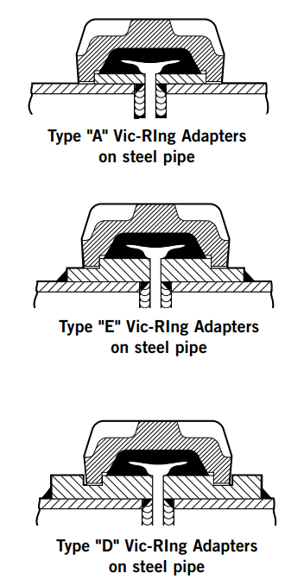
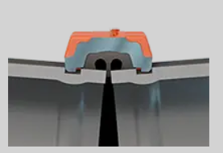
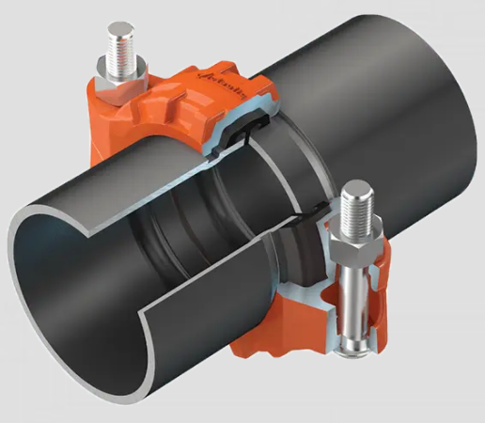
Grooved and Shouldered Coupling
Used with pipe that comes pre-manufactured with grooves on either end. A gasket is wrapped around pipe ends, housing sits inside the pipe grooves and bolts are used to tighten joint together
Coupling used when limited angular movement on pipe is desired while still restraining the pipe joint

Slide 17
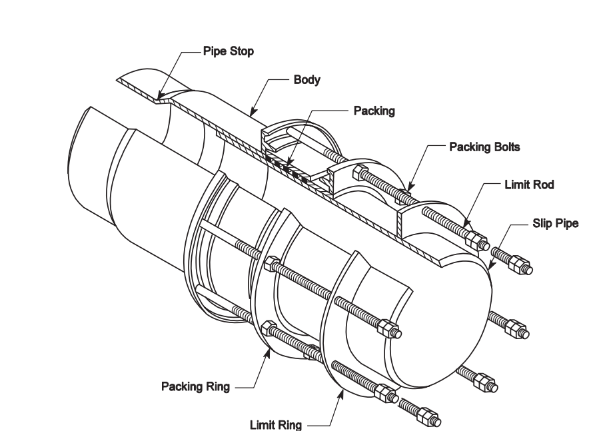
Mechanical Slip Expansion Joint (1)
Used when large axial movement is anticipated in pipe due to thermal expansion/contractor or other factors
Joint can be provided with limiting rods that restrain the amount of movement the pipe can do
The Initial Slip-pipe position is established before installation based on pipe length, temperature changes

Slide 18
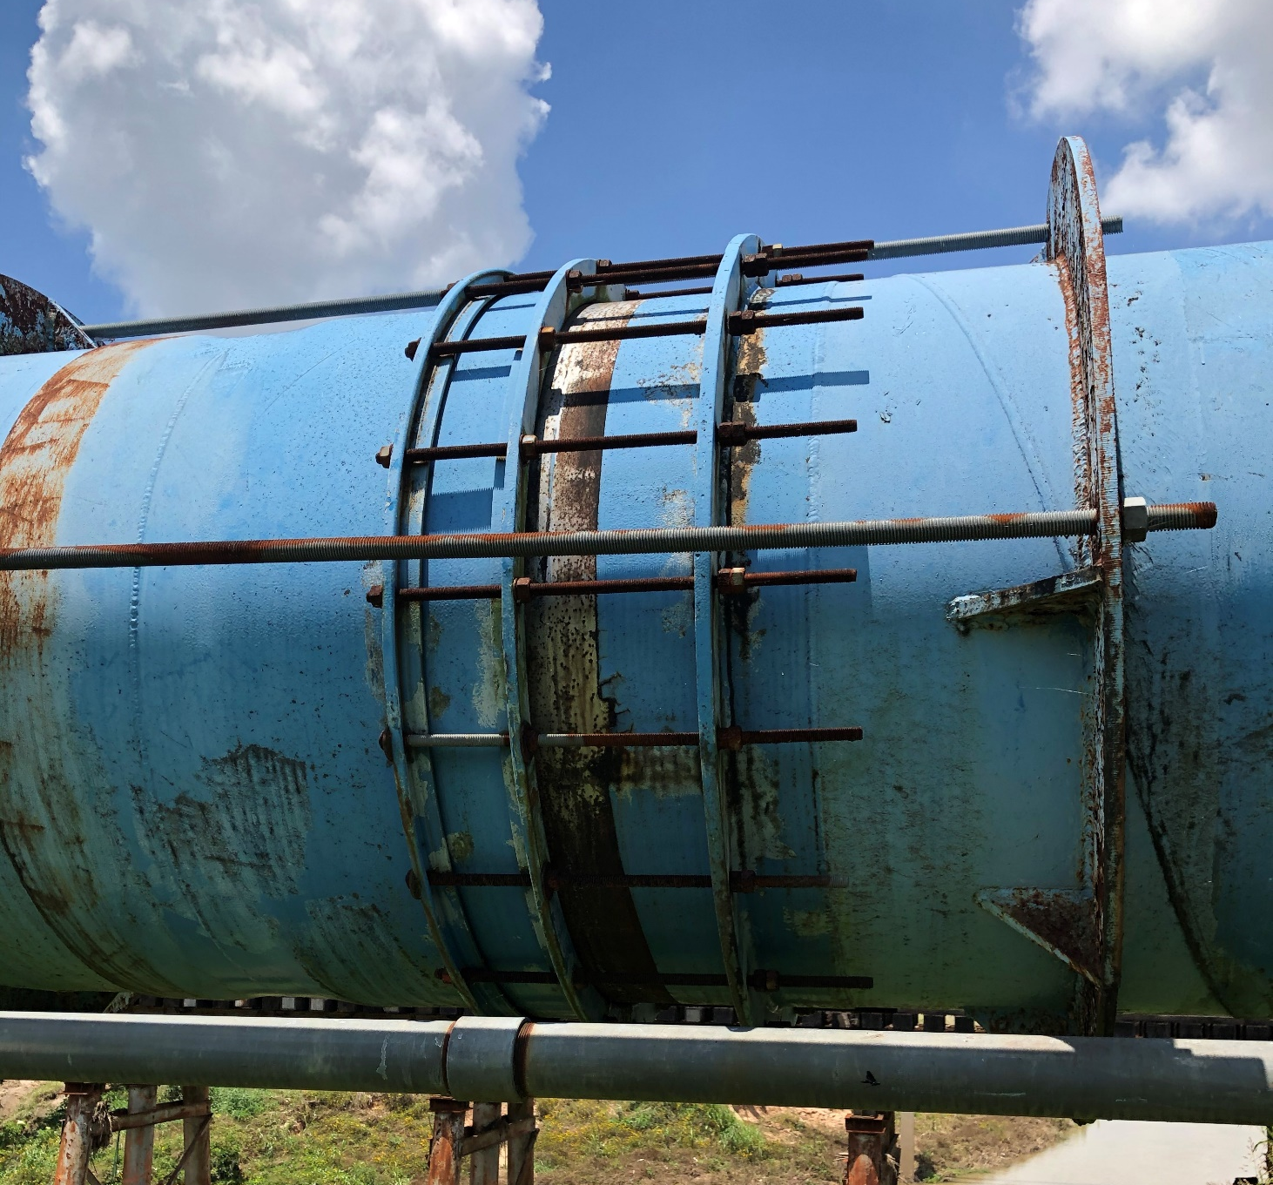
Mechanical Slip Expansion Joint (2)
Need to material and coating of segment of joint that slides back and forth. In marine environments, stainless steel is often the only choice available.

Slide 19
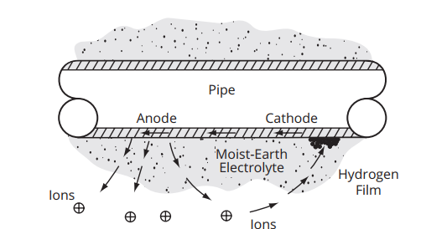
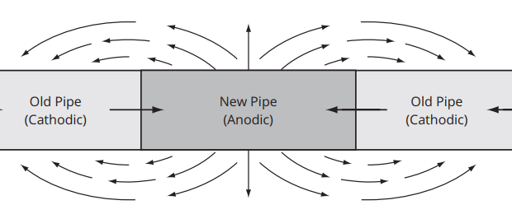
Electrical Insulation
Long section of pipe can conduct electric currents from difference in ground potentials or stray currents. Long section of steel pipe often need to be separated into sections that electrically insulated
When connecting Steel Pipe to Cast Iron, Ductile Iron, Concrete Pressure Pipe need to provide an electrically insulated joint. This allows the cathodic protection system of both pipe to function independently.
Insulation can be done by installing insulating gaskets, sleeves or washers. Insulated couplings can also be used.

